Slide 1


GRAZ BCI 2024 Workshop
Riemannian decoding

Slide 2
Summary
What is the riemannian manifold ?
What are the advantages ?
Common usage

Slide 3
Riemannian manifold

Slide 4
Riemannian manifold
SPD : symmetric positive definite

Slide 5
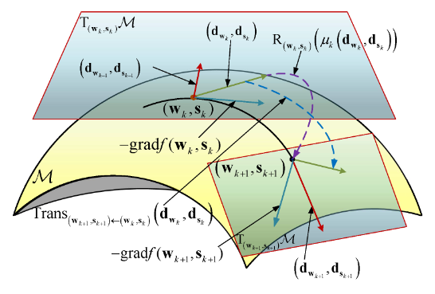


Riemannian manifold
Geometric plan of tangent plan, riemannian manifold and geodesic
Equation to go from manifold to tangent space
Equation to go from tangent space to manifold
Affine invariant metric
Log-euclidian metric
I.E Tibermacine & al. Riemannian Geometry-Based EEG Approaches: A Literature Review. In arXiv, 2024, 10.48550/arXiv.2407.20250

Slide 6
The advantages

Slide 7
The advantages
Reduces noises
Retrieves high statistical information
Helps to extract new features, to create Riemannian classifiers or to perform transfer learning
Improved accuracy classification in a lot of competitions and different paradigms
Contains information of power spectrum and how components vary together over time (useful for connectivity)
-I.E Tibermacine & al. Riemannian Geometry-Based EEG Approaches: A Literature Review. In arXiv, 2024, 10.48550/arXiv.2407.20250
-G. Xu et al., "Attentional State Classification Using Amplitude and Phase Feature Extraction Method Based on Filter Bank and Riemannian Manifold," in IEEE TNSRE, vol. 31, pp. 4402-4412, 2023, doi: 10.1109/TNSRE.2023.3329482
Notes:
The diagonal elements of P represent the variance of the filtered EEG signal at each channel, indicating the power spectrum. The off-diagonal elements provide a measure of covariance between different channels, reflecting how signal components vary together over time—a crucial aspect for understanding functional connectivity in the brain

Slide 8
Common Riemannian usage

Slide 9
Minimum Distance to Mean
Feature j
Class 1
Geometric mean of class
Distance to mean
Classified point
Class 3
Point to classify
Riemannian mean of training dataset
Class 2
Feature i
E. Kalunga & al. Transfer Learning for SSVEP-based BCI using Riemannian similarities between users. 26th European Signal Processing Conference (EUSIPCO 2018), Sep 2018, Rome, Italy. pp.1685-1689, ⟨10.23919/EUSIPCO.2018.8553441⟩. ⟨hal-01911092⟩

Slide 10
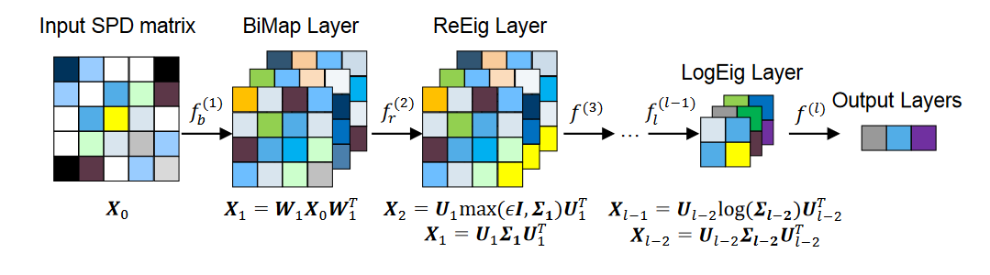
Riemannian space + Tangent space + classifier
Input:
SPD Matrices
Classifier output
Projection to tangent space
Classifier (SVM, LDA…)

Slide 11
SPDNet
[10] Z. Huang and L. Van Gool. A riemannian network for SPD matrix learning. In AAAI, page 9, 2017

Slide 12
Spatial recentering
Feature j
Feature j
Subject 1
Subject 3
Subject 2
Feature i
Feature i
Riemannian mean of training dataset
P.L.C Rodrigues & al. Riemannian Procrustes Analysis : Transfer Learning for Brain-Computer Interfaces. IEEE Transactions on Biomedical Engineering, 2018, 66 (8), pp.2390 - 2401. ⟨10.1109/TBME.2018.2889705⟩. ⟨hal-01971856⟩

Slide 13
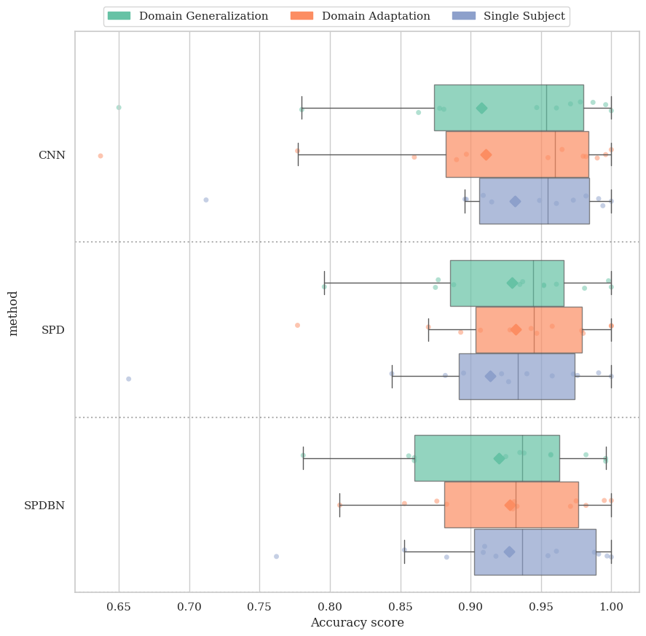
Results
2 SPDNet and a CNN on a BurstCVEP dataset (12 participants)
3 different method
Recentered data
~ 93% accuracy
Riemannian DeepLearning algorithms seems more consistent than CNN
Notes:
Insister sur l’efficacité sur les ERP

Slide 14
Thanks for listening !

